Slide 1
Optimal algorithms for experts and mixtures of Gaussians
Chris Liaw
UBC, August 2020
1

Slide 2
Research overview
Goal: Design & analyze machine learning algorithms with provable guarantees.
2

Slide 3
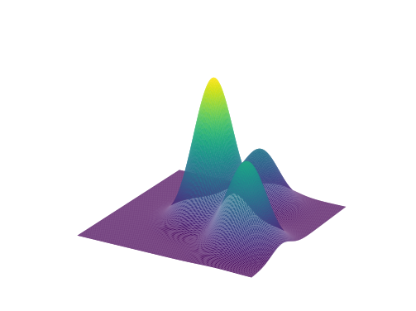
Research overview
Goal: Design & analyze machine learning algorithms with provable guarantees.
Prediction with expert advice
[HLPR, FOCS‘20]
Learning mixtures of Gaussians
[ABHLMP NeurIPS’18, JACM’20]
2

Slide 4
Part 1. Optimal anytime regret with two experts.
Nicholas J. A. Harvey, Christopher Liaw, Edwin Perkins, Sikander Randhawa. Optimal Anytime Regret with Two Experts. FOCS 2020.
3

Slide 5
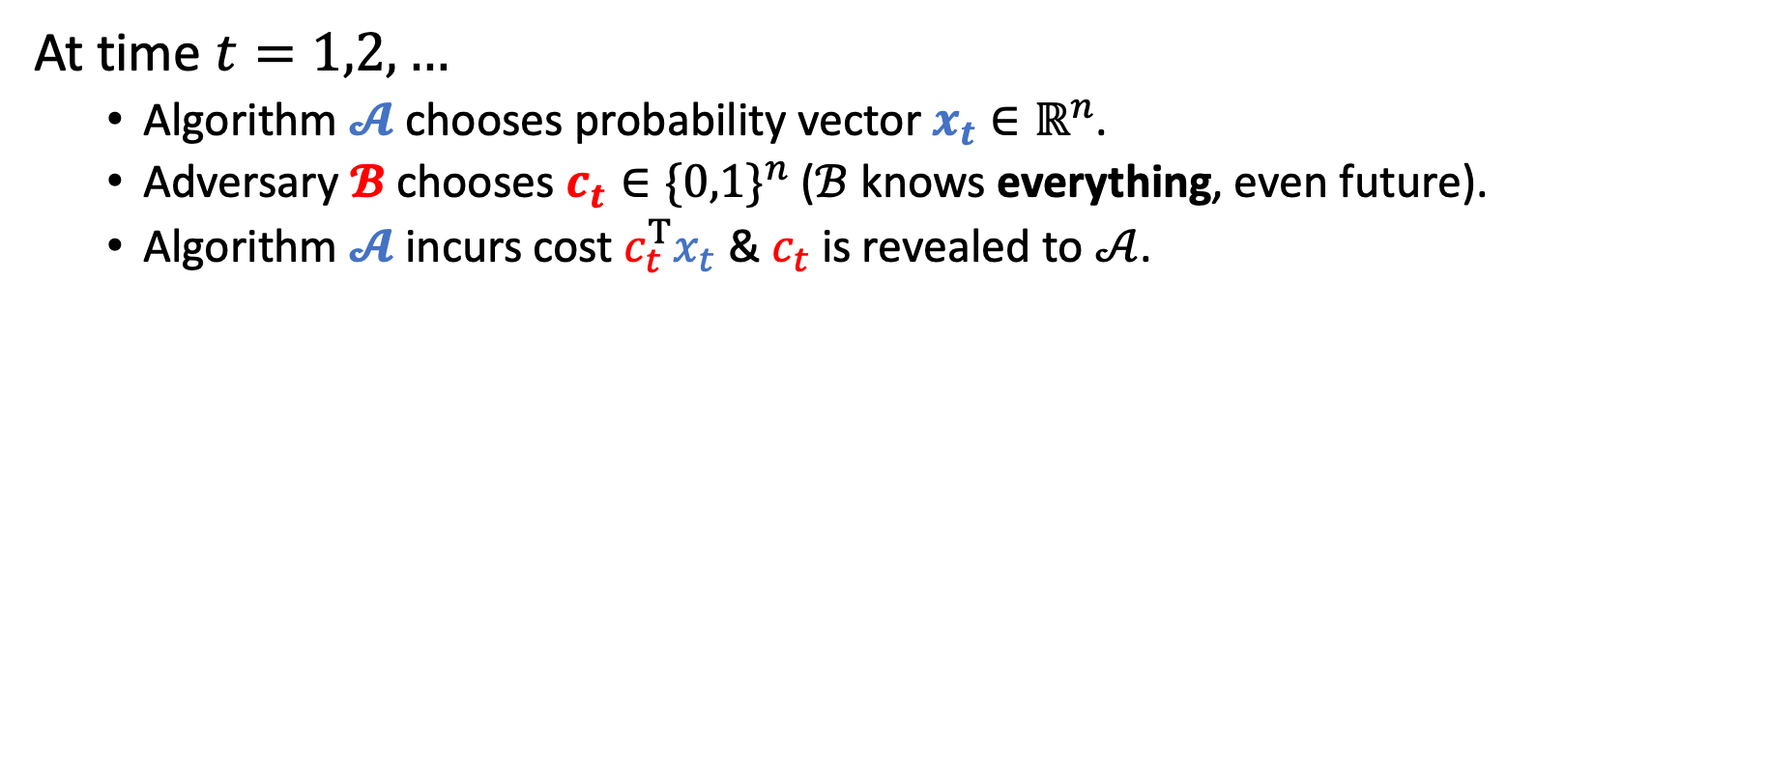
Prediction with expert advice
At time $t=1,2,…$
Algorithm $𝓐$ chooses probability vector $x_{t}∈ℝ^{n}$.
Adversary $𝓑$ chooses $c_{t}∈{\{0,1\}}^{n}$ ($ℬ$ knows everything, even future).
Algorithm $𝓐$ incurs cost $c_{t}^{T}x_{t}$ & $c_{t}$ is revealed to $𝒜$.
4

Slide 6
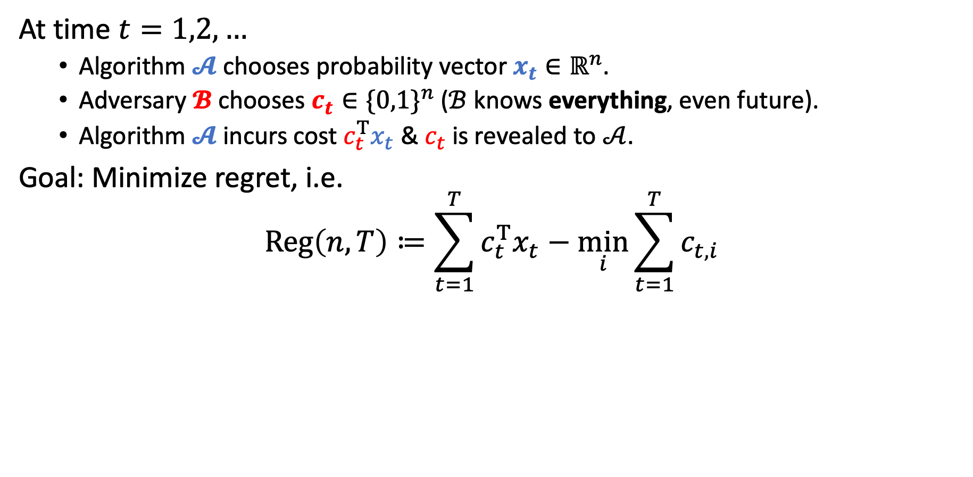
Prediction with expert advice
At time $t=1,2,…$
Algorithm $𝓐$ chooses probability vector $x_{t}∈ℝ^{n}$.
Adversary $𝓑$ chooses $c_{t}∈{\{0,1\}}^{n}$ ($ℬ$ knows everything, even future).
Algorithm $𝓐$ incurs cost $c_{t}^{T}x_{t}$ & $c_{t}$ is revealed to $𝒜$.
Goal: Minimize regret, i.e.
$$Reg\left(n,T\right)≔\sum_{t=1}^{T}{c_{t}^{T}x_{t}}−\min_{i}{\sum_{t=1}^{T}{c_{t,i}}}$$
Algorithm’s cost
Cost of best expert
Note. There is no randomness in the problem.
5

Slide 7
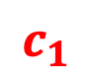
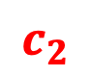
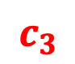
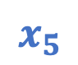
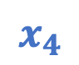



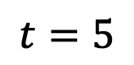
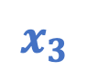
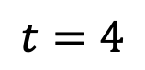
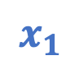
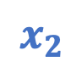
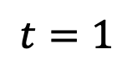
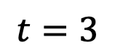
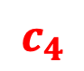
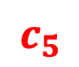
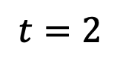

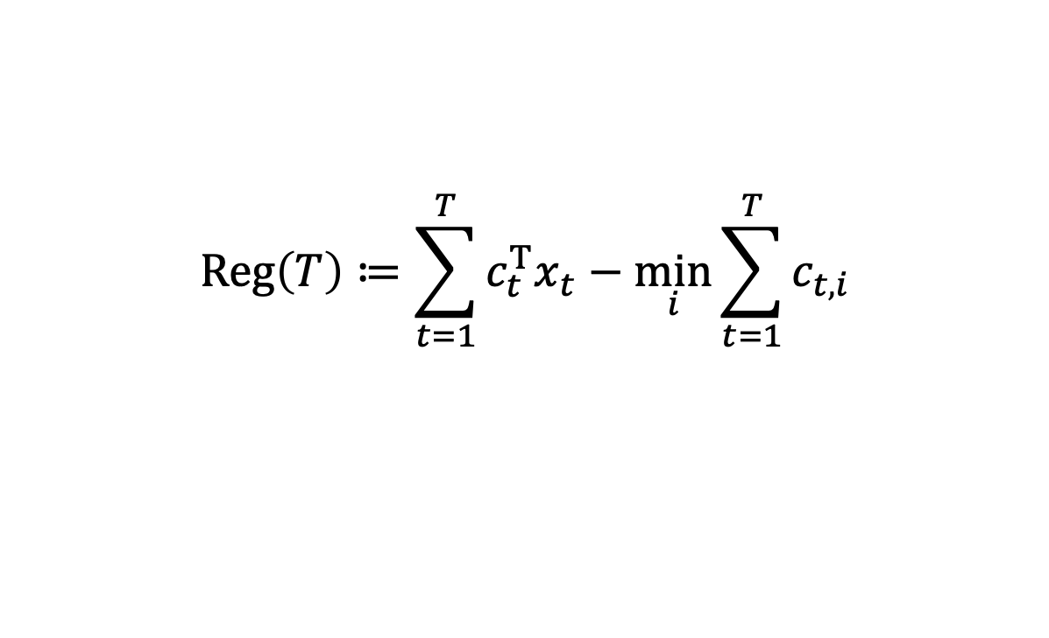



Example
$$Reg\left(T\right)≔\sum_{t=1}^{T}{c_{t}^{T}x_{t}}−\min_{i}{\sum_{t=1}^{T}{c_{t,i}}}$$
Follow best expert?
$$t=1$$
$$t=2$$
$$t=3$$
$$t=4$$
$$t=5$$
$$x_{1}$$
$$c_{1}$$
$$x_{2}$$
$$c_{2}$$
$$x_{3}$$
$$c_{3}$$
$$x_{4}$$
$$c_{4}$$
$$x_{5}$$
$$c_{5}$$
0.5
$$1$$
0.0
$$0$$
0.5
$$0$$
1.0
$$1$$
0.5
$$1$$
0.5
$$0$$
1.0
$$1$$
0.5
$$1$$
0.0
$$0$$
0.5
$$0$$
Algorithm
0.5
1.5
2
3
3.5
Best Expert
0
1
1
2
2
Regret
0.5
0.5
1.0
1.0
1.5
6

Slide 8
Example
$$Reg\left(T\right)≔\sum_{t=1}^{T}{c_{t}^{T}x_{t}}−\min_{i}{\sum_{t=1}^{T}{c_{t,i}}}$$
Follow best expert?
$$t=1$$
$$t=2$$
$$t=3$$
$$t=4$$
$$t=5$$
$$x_{1}$$
$$c_{1}$$
$$x_{2}$$
$$c_{2}$$
$$x_{3}$$
$$c_{3}$$
$$x_{4}$$
$$c_{4}$$
$$x_{5}$$
$$c_{5}$$
0.5
$$1$$
0.0
$$0$$
0.5
$$0$$
1.0
$$1$$
0.5
$$1$$
0.5
$$0$$
1.0
$$1$$
0.5
$$1$$
0.0
$$0$$
0.5
$$0$$
Following best expert can make regret grow linearly.
Algorithm
0.5
1.5
2
3
3.5
Best Expert
0
1
1
2
2
Regret
0.5
0.5
1.0
1.0
1.5
6

Slide 9
Example
$$Reg\left(T\right)≔\sum_{t=1}^{T}{c_{t}^{T}x_{t}}−\min_{i}{\sum_{t=1}^{T}{c_{t,i}}}$$
A little hedging…
$$t=1$$
$$t=2$$
$$t=3$$
$$t=4$$
$$t=5$$
$$x_{1}$$
$$c_{1}$$
$$x_{2}$$
$$c_{2}$$
$$x_{3}$$
$$c_{3}$$
$$x_{4}$$
$$c_{4}$$
$$x_{5}$$
$$c_{5}$$
0.5
$$1$$
0.4
$$0$$
0.5
$$0$$
0.6
$$1$$
0.5
$$1$$
0.5
$$0$$
0.6
$$1$$
0.5
$$1$$
0.4
$$0$$
0.5
$$0$$
Algorithm
0.5
1.1
1.6
2.2
2.7
Best Expert
0
1
1
2
2
Regret
0.5
0.1
0.6
0.2
0.7
7

Slide 10
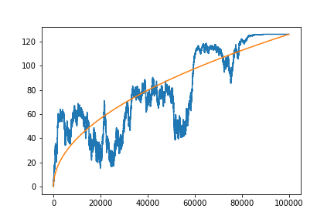
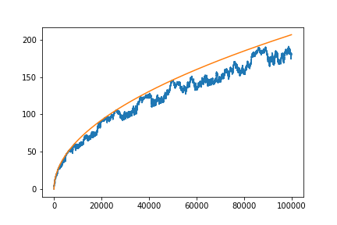

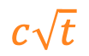

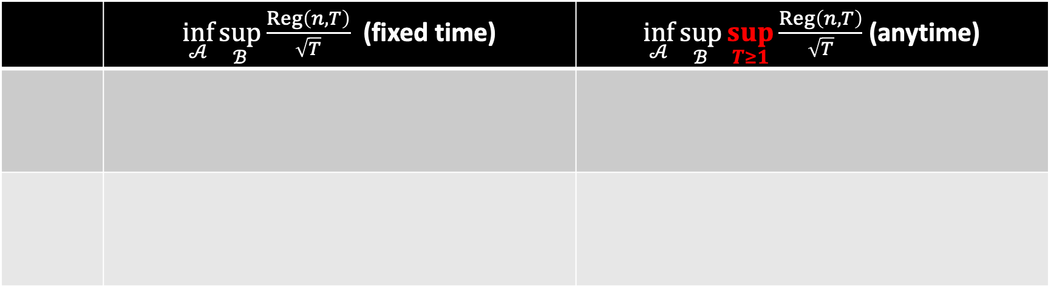
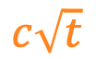
Known results
 | $\inf_{𝒜}{\sup_{ℬ}{\frac{Reg\left(n,T\right)}{\sqrt{T}}}}$ (fixed time) | $\inf_{𝒜}{\sup_{ℬ}{\sup_{T≥1}{\frac{Reg\left(n,T\right)}{\sqrt{T}}}}}$ (anytime)
$$c\sqrt{t}$$
$$c\sqrt{t}$$
$$Reg\left(t\right)$$
$$Reg\left(t\right)$$
8

Slide 11
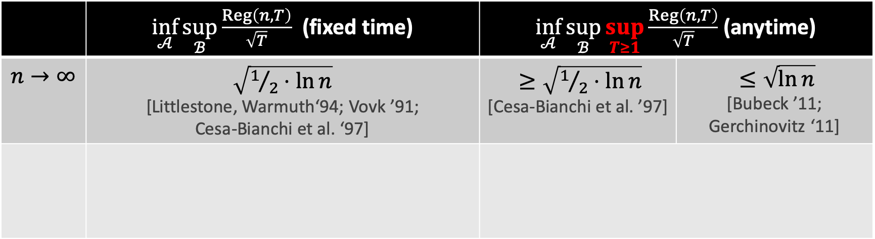
Known results
 | $\inf_{𝒜}{\sup_{ℬ}{\frac{Reg\left(n,T\right)}{\sqrt{T}}}}$ (fixed time) | $\inf_{𝒜}{\sup_{ℬ}{\sup_{T≥1}{\frac{Reg\left(n,T\right)}{\sqrt{T}}}}}$ (anytime)
$$n→∞$$ | $\sqrt{1/2⋅ln{n}}$ [Littlestone, Warmuth‘94; Vovk ’91; Cesa-Bianchi et al. ‘97] | $≥\sqrt{1/2⋅\ln{n}}$ [Cesa-Bianchi et al. ’97] | $≤\sqrt{\ln{n}}$ [Bubeck ’11; Gerchinovitz ‘11]
$$c\sqrt{t}$$
$$c\sqrt{t}$$
$$Reg\left(t\right)$$
$$Reg\left(t\right)$$
8

Slide 12
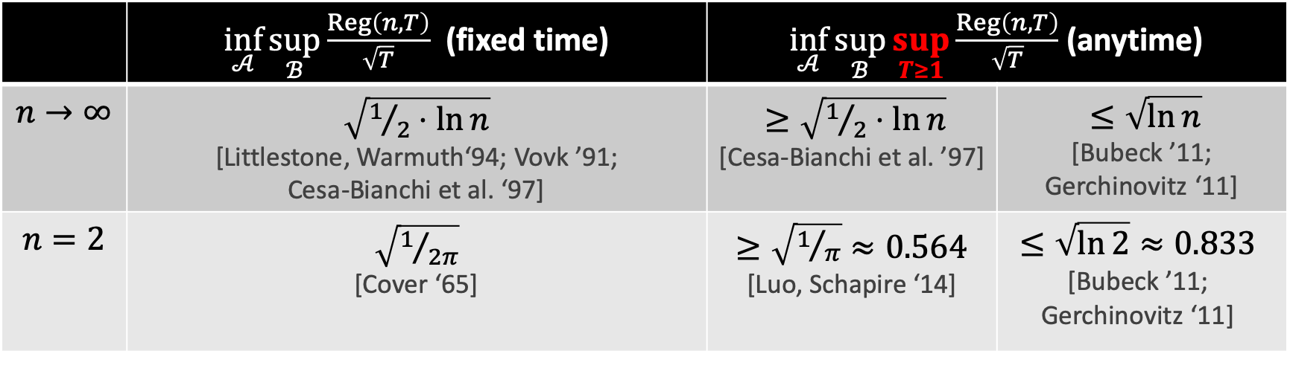
Known results
 | $\inf_{𝒜}{\sup_{ℬ}{\frac{Reg\left(n,T\right)}{\sqrt{T}}}}$ (fixed time) | $\inf_{𝒜}{\sup_{ℬ}{\sup_{T≥1}{\frac{Reg\left(n,T\right)}{\sqrt{T}}}}}$ (anytime)
$$n→∞$$ | $\sqrt{1/2⋅ln{n}}$ [Littlestone, Warmuth‘94; Vovk ’91; Cesa-Bianchi et al. ‘97] | $≥\sqrt{1/2⋅\ln{n}}$ [Cesa-Bianchi et al. ’97] | $≤\sqrt{\ln{n}}$ [Bubeck ’11; Gerchinovitz ‘11]
$$n=2$$ | $\sqrt{1/{2π}}$ [Cover ‘65] | $≥\sqrt{1/π}≈0.564$ [Luo, Schapire ‘14] | $$≤\sqrt{\ln{2}}≈0.833$$ [Bubeck ’11; Gerchinovitz ‘11]
$$c\sqrt{t}$$
$$c\sqrt{t}$$
$$Reg\left(t\right)$$
$$Reg\left(t\right)$$
8

Slide 13
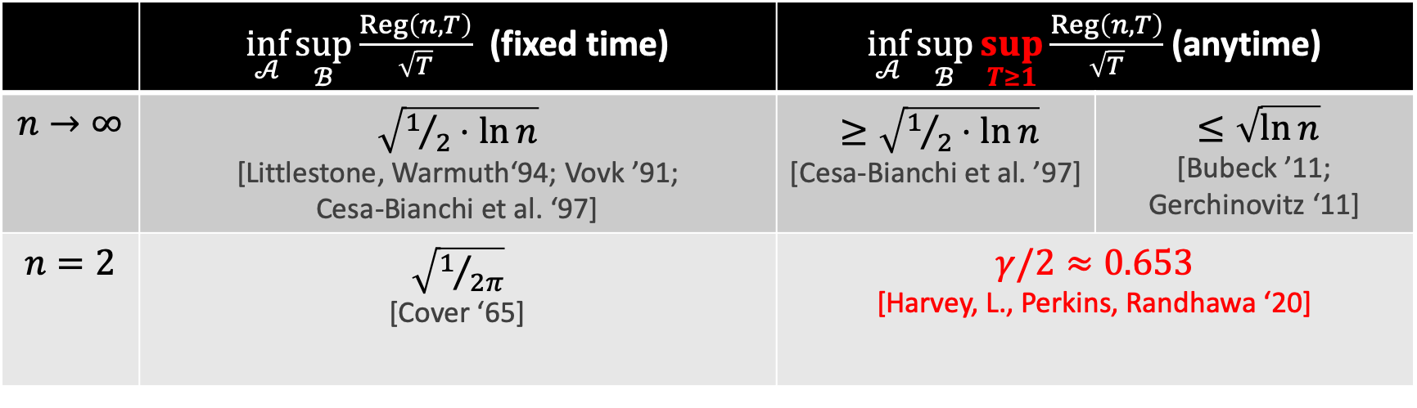
Known results
 | $\inf_{𝒜}{\sup_{ℬ}{\frac{Reg\left(n,T\right)}{\sqrt{T}}}}$ (fixed time) | $\inf_{𝒜}{\sup_{ℬ}{\sup_{T≥1}{\frac{Reg\left(n,T\right)}{\sqrt{T}}}}}$ (anytime)
$$n→∞$$ | $\sqrt{1/2⋅ln{n}}$ [Littlestone, Warmuth‘94; Vovk ’91; Cesa-Bianchi et al. ‘97] | $≥\sqrt{1/2⋅\ln{n}}$ [Cesa-Bianchi et al. ’97] | $≤\sqrt{\ln{n}}$ [Bubeck ’11; Gerchinovitz ‘11]
$$n=2$$ | $\sqrt{1/{2π}}$ [Cover ‘65] | $γ/2≈0.653$ [Harvey, L., Perkins, Randhawa ‘20]
$$c\sqrt{t}$$
$$c\sqrt{t}$$
$$Reg\left(t\right)$$
$$Reg\left(t\right)$$
8

Slide 14
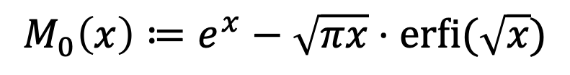
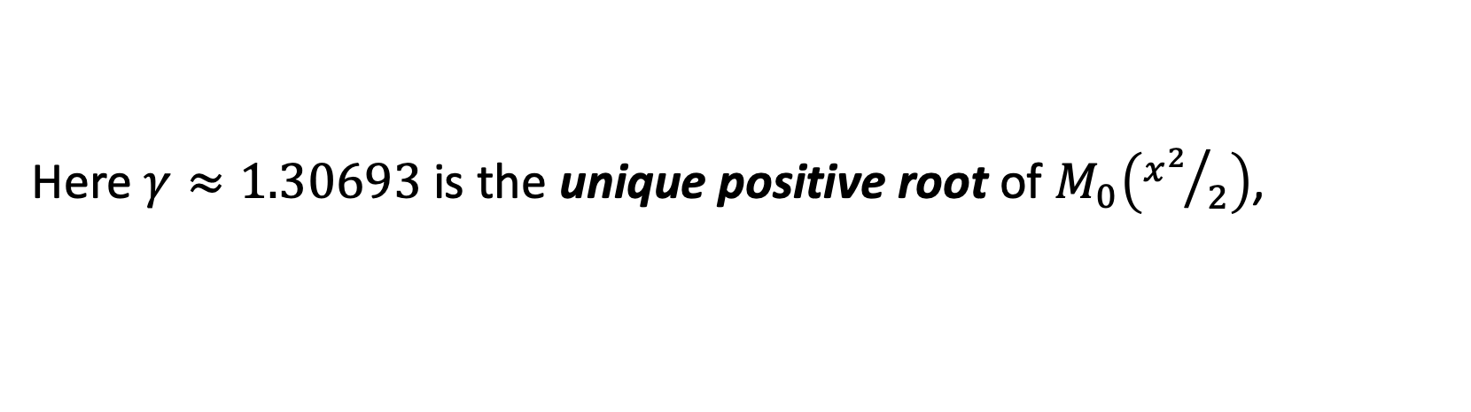
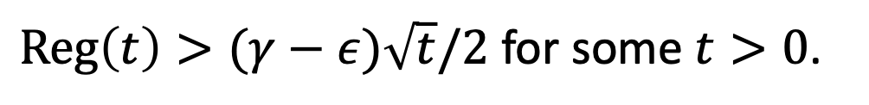
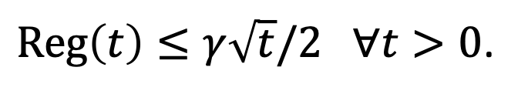
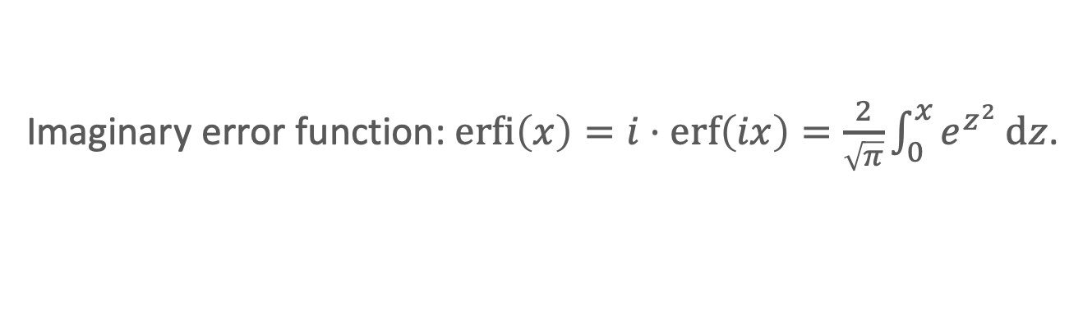
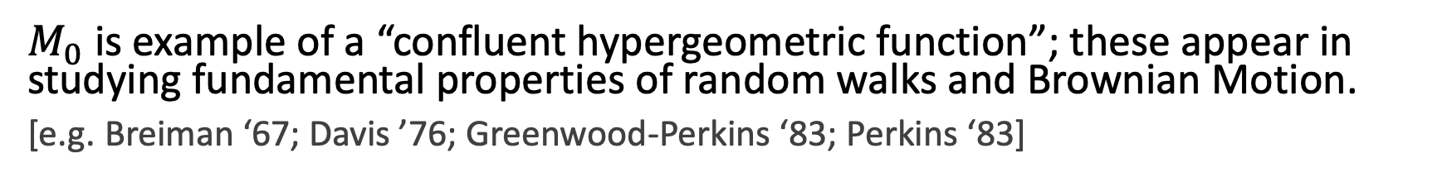
Our result
Imaginary error function: $\operatorname{erfi}\left(x\right)=i⋅erf\left(ix\right)=\frac{2}{\sqrt{π}}\int_{0}^{x}{e^{z^{2}}}dz$.
Theorem [HLPR ‘20]
For $n=2$ experts, there is an alg. that guarantees (against all adversaries)
$Reg\left(t\right)≤γ\sqrt{t}/2 ∀t>0$.
Moreover, for any algorithm and $ε>0$, there is adversary that forces
$Reg\left(t\right)>(γ−ε)\sqrt{t}/2$ for some $t>0$.
Here $γ≈1.30693$ is the unique positive root of $M_{0}\left({x^{2}}/2\right)$,
$$M_{0}\left(x\right)≔e^{x}−\sqrt{πx}⋅\operatorname{erfi}{(\sqrt{x}})$$
$M_{0}$ is example of a “confluent hypergeometric function”; these appear in studying fundamental properties of random walks and Brownian Motion.
[e.g. Breiman ‘67; Davis ’76; Greenwood-Perkins ‘83; Perkins ‘83]
Next: Discuss use of stochastic calculus & PDEs to design optimal algorithm.
9

Slide 15
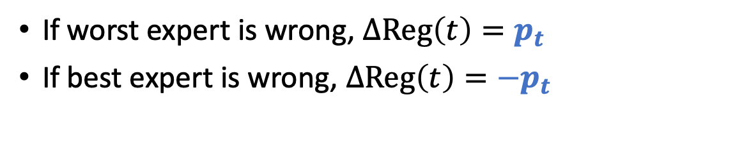
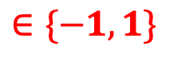
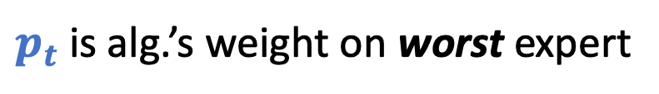
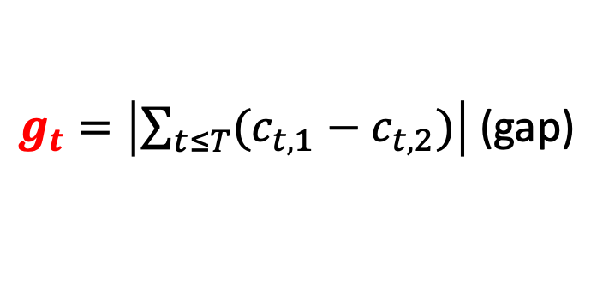
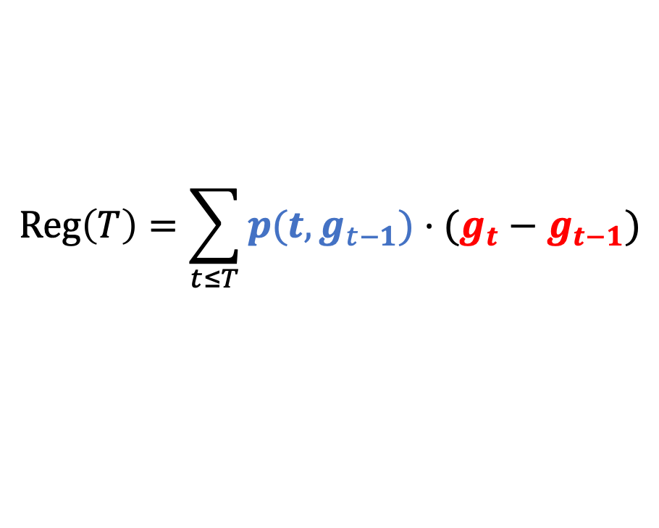
Regret as a stochastic integral
Discrete regret for two experts.
$$Reg\left(T\right)=\sum_{t≤T}{p(t,g_{t−1})⋅(g_{t}−g_{t−1})}$$
$g_{t}=\left|\sum_{t≤T}{(c_{t,1}−c_{t,2})}\right|$ (gap)
$$∈\{−1,1\}$$
$p_{t}$ is alg.’s weight on worst expert
If worst expert is wrong, $ΔReg\left(t\right)=p_{t}$
If best expert is wrong, $ΔReg\left(t\right)={−p}_{t}$
10

Slide 16

Regret as a stochastic integral
Discrete regret for two experts.
$$Reg\left(T\right)=\sum_{t≤T}{p(t,g_{t−1})⋅(g_{t}−g_{t−1})}$$
$g_{t}=\left|\sum_{t≤T}{(c_{t,1}−c_{t,2})}\right|$ (gap)
$$∈\{−1,1\}$$
$p_{t}$ is alg.’s weight on worst expert
Idea. View $g_{t}$ as reflected random walk. Goal. Control $Reg\left(T\right)$ a.s.
Alg/Adv play at discrete times.
10

Slide 17
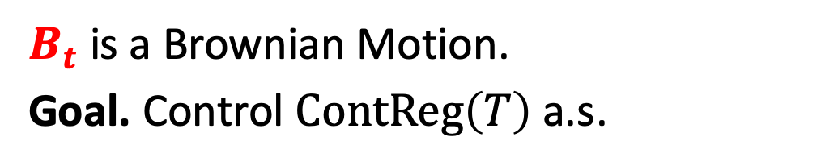
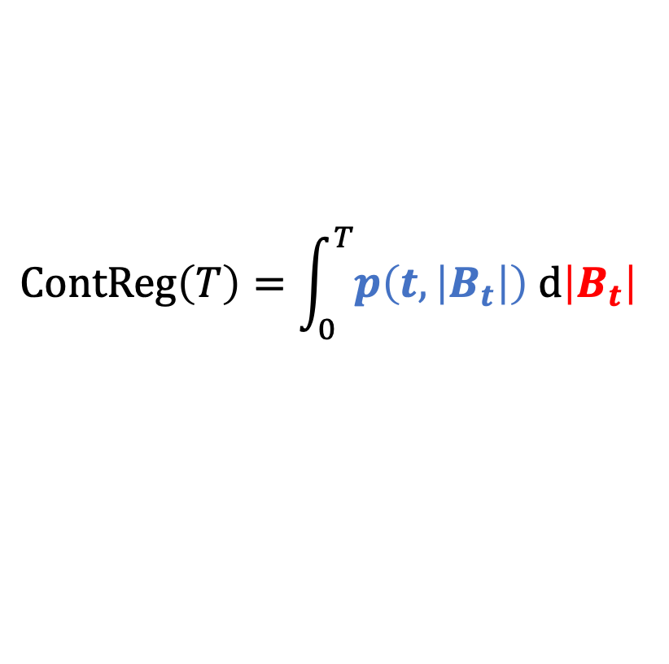
Regret as a stochastic integral
Discrete regret for two experts.
Continuous regret for two experts.
$$Reg\left(T\right)=\sum_{t≤T}{p(t,g_{t−1})⋅(g_{t}−g_{t−1})}$$
$$ContReg\left(T\right)=\int_{0}^{T}{p\left(t,\left|B_{t}\right|\right) d\left|B_{t}\right| }$$
Idea. View $g_{t}$ as reflected random walk. Goal. Control $Reg\left(T\right)$ a.s.
$B_{t}$ is a Brownian Motion.
Goal. Control $ContReg\left(T\right)$ a.s.
Alg/Adv play at discrete times.
Alg/Adv play continuously.
10

Slide 18
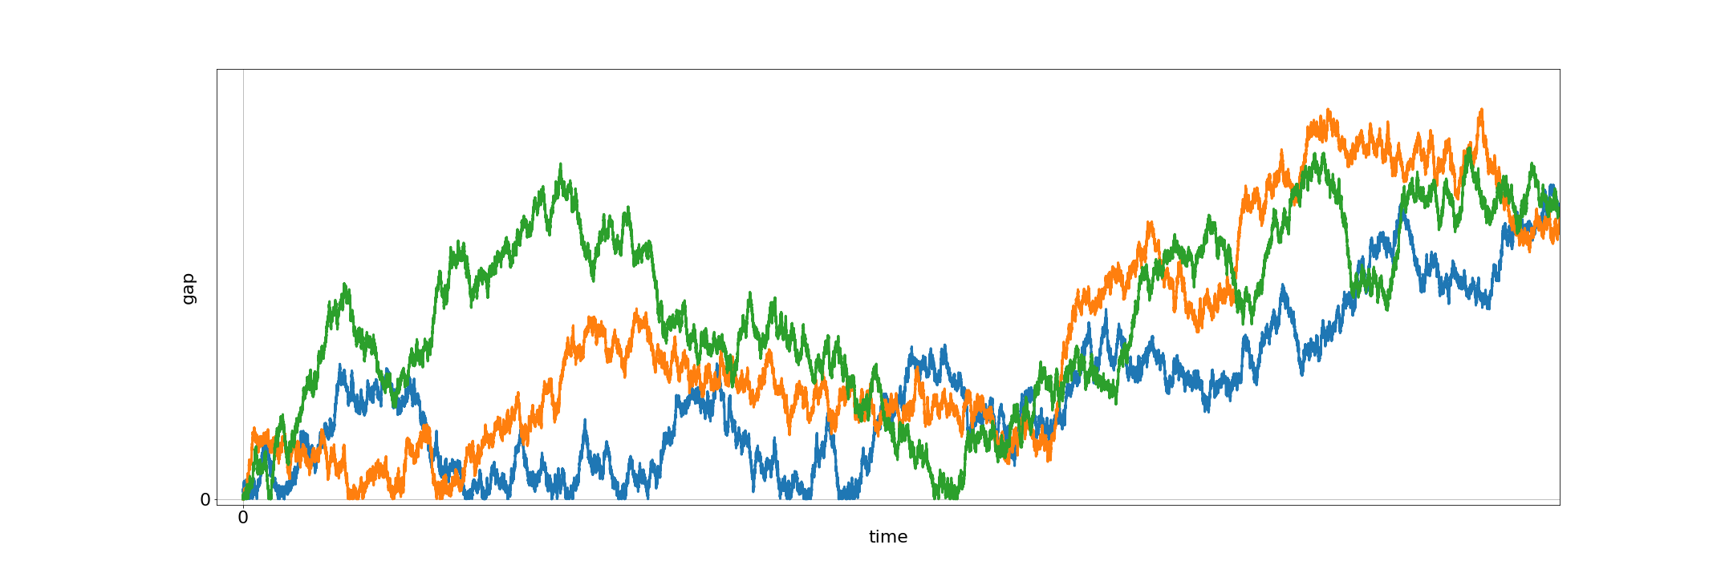
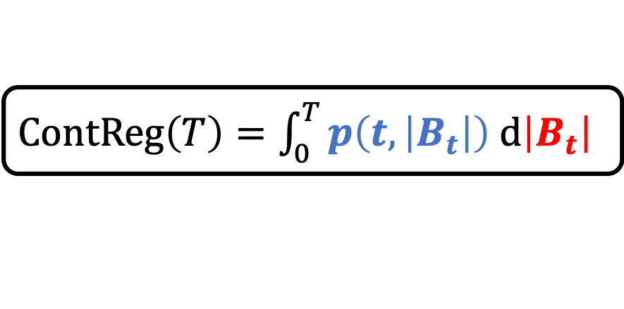
Designing the algorithm
$ContReg\left(T\right)=\int_{0}^{T}{p\left(t,\left|B_{t}\right|\right) d\left|B_{t}\right| }$
Kiyoshi Itô
Key Idea. Design $p$ so that all paths w/ common endpoints have equal regret.
$$ContReg\left(T\right)≠ContReg\left(T\right)≠ContReg(T)$$
11

Slide 19
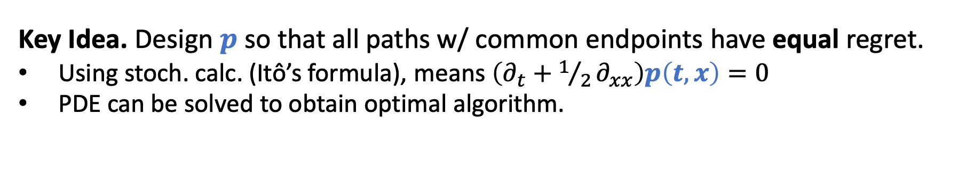
Designing the algorithm
$ContReg\left(T\right)=\int_{0}^{T}{p\left(t,\left|B_{t}\right|\right) d\left|B_{t}\right| }$
Kiyoshi Itô
Key Idea. Design $p$ so that all paths w/ common endpoints have equal regret.
Using stoch. calc. (Itô’s formula), means $\left(∂_{t}+1/2∂_{xx}\right)p\left(t,x\right)=0$
PDE can be solved to obtain optimal algorithm.
Miracle. Arguments can be discretized with no loss.
$$ContReg\left(T\right)=ContReg\left(T\right)=ContReg(T)$$
11

Slide 20
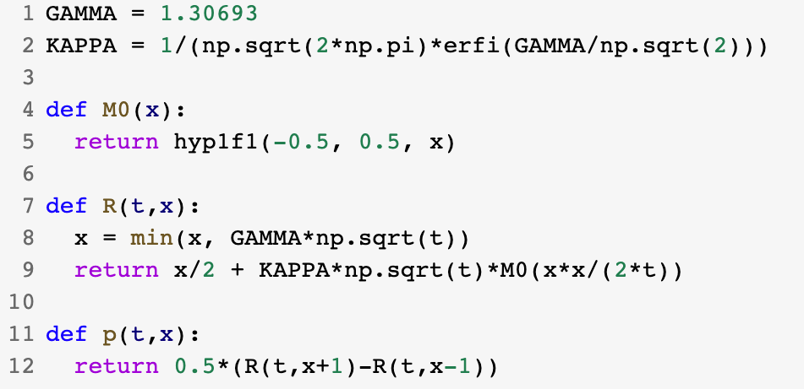
Python implementation
12

Slide 21
Part 2. Sample-optimal algorithms for learning mixtures of Gaussians.
Hassan Ashtiani, Shai Ben-David, Nicholas J. A. Harvey, Christopher Liaw, Abbas Mehrabian, Yaniv Plan. Near-optimal Sample Complexity Bounds for Robust Learning of Gaussian Mixtures via Compression Schemes. Journal of the ACM. 2020.
13

Slide 22

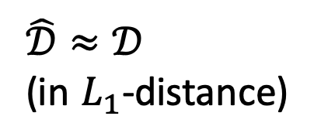
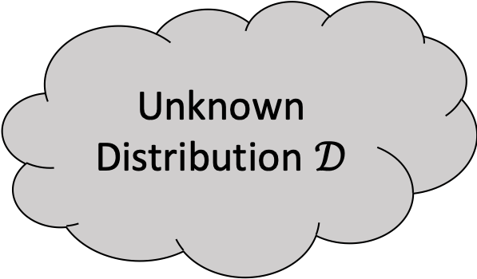
Density estimation
Unknown Distribution $𝒟$
i.i.d. samples
$$\hat{𝒟}≈𝒟$$
(in $L_{1}$-distance)
14

Slide 23
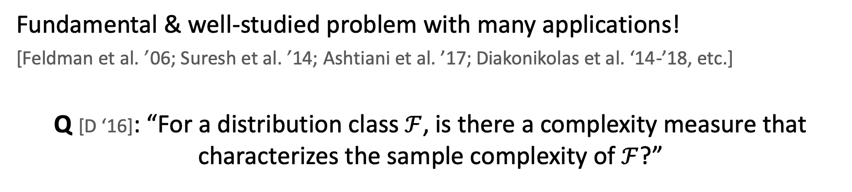
Density estimation
Unknown Distribution $𝒟$
i.i.d. samples
$$\hat{𝒟}≈𝒟$$
(in $L_{1}$-distance)
Fundamental & well-studied problem with many applications!
[Feldman et al. ’06; Suresh et al. ’14; Ashtiani et al. ’17; Diakonikolas et al. ‘14-’18, etc.]
Q [D ‘16]: “For a distribution class $ℱ$, is there a complexity measure that characterizes the sample complexity of $ℱ$?”
14

Slide 24
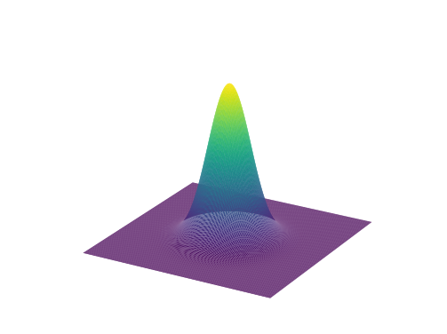
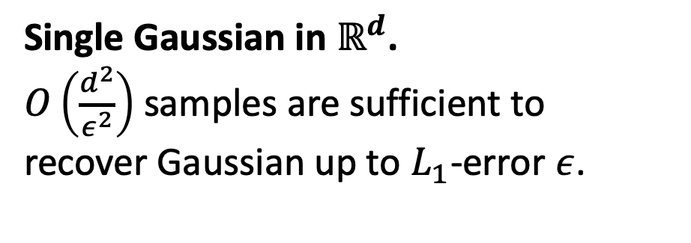
Learning Gaussians
Single Gaussian in $ℝ^{d}$.
$O\left(\frac{d^{2}}{ε^{2}}\right)$ samples are sufficient to
recover Gaussian up to $L_{1}$-error $ε$.
15

Slide 25
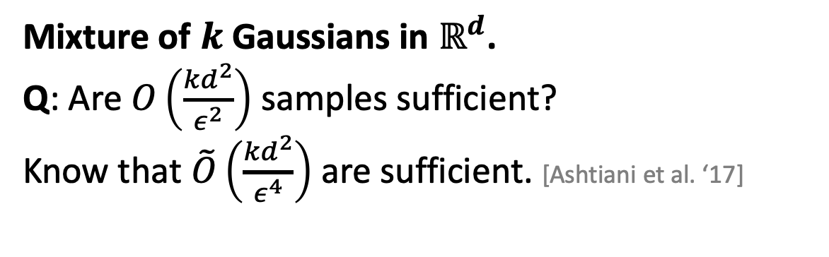
Learning Gaussians
Single Gaussian in $ℝ^{d}$.
$O\left(\frac{d^{2}}{ε^{2}}\right)$ samples are sufficient to
recover Gaussian up to $L_{1}$-error $ε$.
Mixture of $k$ Gaussians in $ℝ^{d}$.
Q: Are $O\left(\frac{{kd}^{2}}{ε^{2}}\right)$ samples sufficient?
Know that $\tilde{O}\left(\frac{{kd}^{2}}{ε^{4}}\right)$ are sufficient. [Ashtiani et al. ‘17]
Note: We aim to recover density, not parameters of the mixture.
15

Slide 26
Main contribution
“Other things being equal, simpler explanations are generally better…” [William of Ockham]
One manifestation of this in learning theory is “sample compression”.
[e.g. Littlestone, Warmuth ‘86; Moran, Yehudayoff ‘16]
16

Slide 27
Main contribution
“Other things being equal, simpler explanations are generally better…” [William of Ockham]
One manifestation of this in learning theory is “sample compression”.
[e.g. Littlestone, Warmuth ‘86; Moran, Yehudayoff ‘16]
We introduce a simple & sample-efficient technique for density estimation via compression schemes.
16

Slide 28


Main contribution
“Other things being equal, simpler explanations are generally better…” [William of Ockham]
One manifestation of this in learning theory is “sample compression”.
[e.g. Littlestone, Warmuth ‘86; Moran, Yehudayoff ‘16]
We introduce a simple & sample-efficient technique for density estimation via compression schemes.
Application: $\tilde{O}\left({kd}^{2}/ε^{2}\right)$ samples to learn mixtures of $k$ Gaussians in $ℝ^{d}$.
We also show nearly-matching lower bound of $\tilde{Ω}\left({kd}^{2}/ε^{2}\right)$.
*Note: $\tilde{O}$ and $\tilde{Ω}$ hide $polylog(kd/ε)$ factors.
16

Slide 29




Compression Gaussians in $ℝ$
$$𝒩\left(μ, σ^{2}\right)$$
$$μ−σ$$
$$μ$$
$$μ+σ$$
17

Slide 30
Compression Gaussians in $ℝ$
$$𝒩\left(μ, σ^{2}\right)$$
$$μ−σ$$
$$μ$$
$$μ+σ$$
17

Slide 31





Compression Gaussians in $ℝ$
$$𝒩\left(μ, σ^{2}\right)$$
$$X_{1}$$
$$X_{2}$$
$$μ−σ$$
$$μ$$
$$μ+σ$$
$$\frac{X_{2}+X_{1}}{2}≈μ$$
$$\frac{X_{2}−X_{1}}{2}≈σ$$
Two samples are sufficient to encode $𝒩\left(μ, σ^{2}\right)$.
17

Slide 32






Compression framework
$ℱ$: a class of densities (e.g. Gaussians)
$m$ i.i.d. samples
from $f∈ℱ$
$t$ points
reconstruct
$$\hat{f}≈f$$
Knows $f$, $ℱ$
Knows $ℱ$
If Alice draws $m$ samples, sends $t$ points,
and $d_{TV}\left(f,\hat{f}\right)<ε$ then $ℱ$ admits $t$-compression.
18

Slide 33

Compression framework
$ℱ$: a class of densities (e.g. Gaussians)
$m$ i.i.d. samples
from $f∈ℱ$
$t$ points
reconstruct
$$\hat{f}≈f$$
Knows $f$, $ℱ$
Knows $ℱ$
If Alice draws $m$ samples, sends $t$ points,
and $d_{TV}\left(f,\hat{f}\right)<ε$ then $ℱ$ admits $t$-compression.
18

Slide 34


Compression Theorem
Theorem [ABHLMP ‘18]
If $ℱ$ has a compression scheme of size $t$ then sample complexity to learn $ℱ$ (up to $L_{1}$-error $ε$) is
$$\tilde{O}\left(\frac{t}{ε^{2}}\right).$$
$\tilde{O}\left(∙\right)$ hides polylog factors
Small compression schemes imply
sample-efficient algorithms.
19

Slide 35



Compression of mixtures
Cheat: assume a uniform mixture.
$$𝒩\left(μ_{3}, σ_{3}^{2}\right)$$
$$𝒩\left(μ_{1}, σ_{1}^{2}\right)$$
$$𝒩\left(μ_{2}, σ_{2}^{2}\right)$$
20

Slide 36
Compression of mixtures
Cheat: assume a uniform mixture.
$$𝒩\left(μ_{3}, σ_{3}^{2}\right)$$
$$𝒩\left(μ_{1}, σ_{1}^{2}\right)$$
$$𝒩\left(μ_{2}, σ_{2}^{2}\right)$$
20

Slide 37









Compression of mixtures
Cheat: assume a uniform mixture.
$$𝒩\left(μ_{3}, σ_{3}^{2}\right)$$
$$𝒩\left(μ_{1}, σ_{1}^{2}\right)$$
$$𝒩\left(μ_{2}, σ_{2}^{2}\right)$$
$$X_{1}$$
$$X_{2}$$
$$X_{3}$$
$$X_{4}$$
$$X_{5}$$
$$X_{6}$$
$$X_{1}≈μ_{1}−σ_{1}$$
$$X_{2}≈μ_{1}+σ_{1}$$
$$X_{3}≈μ_{2}−σ_{2}$$
$$X_{4}≈μ_{2}+σ_{2}$$
$$X_{5}≈μ_{3}−σ_{3}$$
$$X_{6}≈μ_{3}+σ_{3}$$
20

Slide 38

Compression of mixtures
Cheat: assume a uniform mixture.
$$𝒩\left(μ_{3}, σ_{3}^{2}\right)$$
$$𝒩\left(μ_{1}, σ_{1}^{2}\right)$$
$$𝒩\left(μ_{2}, σ_{2}^{2}\right)$$
$$X_{1}$$
$$X_{2}$$
$$X_{3}$$
$$X_{4}$$
$$X_{5}$$
$$X_{6}$$
If $ℱ$ has $t$-compression then
$k$ mixtures of $ℱ$ have $\sim kt\text{−}\text{compression}$.
20

Slide 39

Compression Theorem for mixtures
Theorem [ABHLMP ‘18]
If $ℱ$ has a compression scheme of size $t$ then sample complexity to learn $k$ mixtures of $ℱ$ (up to $L_{1}$-error $ε$) is
$$\tilde{O}\left(\frac{kt}{ε^{2}}\right).$$
$\tilde{O}\left(∙\right)$ hides polylog factors
Small compression schemes imply
sample-efficient algorithms for mixtures.
21

Slide 40






Compression scheme for Gaussians
$$X_{2}$$
To recover $𝒩\left(0, Σ\right)$, suffices to encode eigenvectors/eigenvalues of $Σ$.
Idea: Encode axes of ellipsoid using linear combination of samples.
Claim. Can encode an axis w/ $\sim d$ samples.
Total: $\sim d^{2}$ samples for all $d$ axes.
$$v_{1}$$
$$v_{2}$$
$$X_{1}$$
Ellipsoid defined by $Σ$.
Points drawn from $𝒩\left(0, Σ\right)$.
22

Slide 41




Application: Learning mixtures of Gaussians
Theorem [ABHLMP ‘18]
Sample complexity for learning mixtures of $k$ Gaussians in $ℝ^{d}$ up to $L_{1}$-error $ε$ is
$$\tilde{O}\left(\frac{kd^{2}}{ε^{2}}\right).$$
$\tilde{O}\left(∙\right)$ hides polylog factors
Improves upon:
$O(k^{4}d^{4}/ε^{2})$ via a VC-dimension argument
$\tilde{O}(kd^{2}/ε^{4})$ [Ashtiani, Ben-David, Mehrabian ‘17]
Theorem [ABHLMP ‘18]
Any algorithm for mixture of $k$ Gaussians with success probability 0.5001 requires $\tilde{Ω}\left({kd^{2}}/{ε^{2}}\right)$ samples.
23

Slide 42
Summary
Prediction with expert advice
Uses ideas from stochastic calculus & PDEs to design optimal algorithm for two experts.
Lower bound uses martingales, Davis’ inequality, optional stopping.
Learning mixtures of Gaussians
Illustrates compression framework to design sample-efficient algorithms for density estimation.
24

Slide 43


I am grateful to my committee...
25

Slide 44






& amazing co-authors, friends…
26

Slide 45
Thank you!
27

